Slide 1
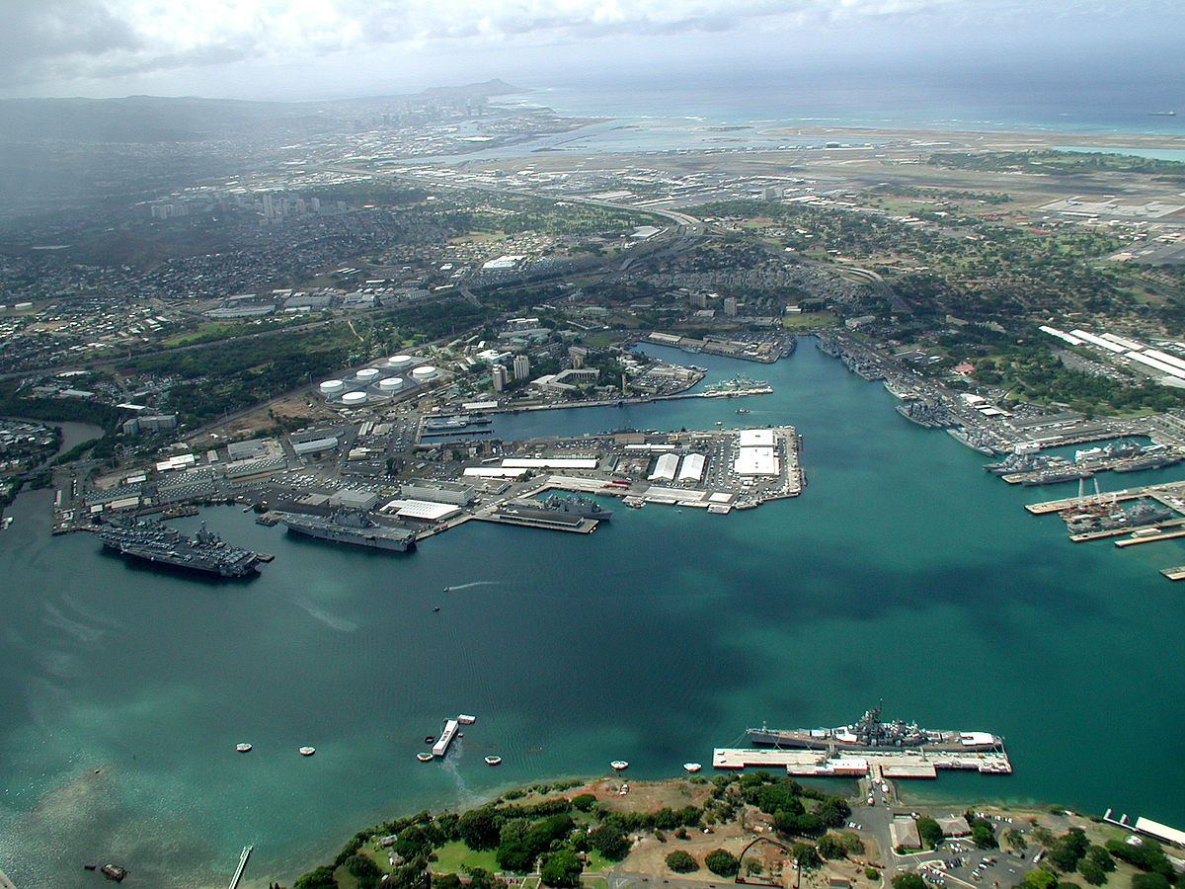

USS John Finn (DDG 113)
NAVIGATION BRIEF
PEARL HARBOR, HI OUTBOUND
25 MAR 2021
____________________ ____________________ ____________________
NAV XO CO
UNCLASSIFIED – FOR OFFICIAL USE ONLY (FOUO)

Slide 2
USS John Finn (DDG 113) REFERENCES
Navigator
CNSL/CNSP/CNAL/CNAP 3530.4F NAVDORM
JOHNFINNINST 3121.1D
Coast Pilot 7, Chapters 2 & 4
PUB 941 Pearl Harbor Fleet Guide
UNCLASSIFIED

Slide 3
USS John Finn (DDG 113) WATCHBILL
Navigator
BRIDGE
OOD | LTJG Gormley ENS Lutton (U/I)
JOOD | ENS Conkey
JOOW | LTJG Bilden
CONN | ENS Peterson
NAV Evaluator | LTJG Lowery
VMS Operator | QMC Heindl
Helm Safety Officer | ENS Byrom
Master Helmsman | RS3 Howard
Lee Helmsman | BMSN Williams
Shipping Liaison | OS2 Barry
CIC
CICWO | LTJG Valencia ENS Giannotti (U/I)
Shipping Officer | OS1 Ronsse
Piloting Officer | OS2 Harris
CCS
PCO | LT Chillmen
EOOW | GSCS Lapid
PACC | GSM2 Martorano
EPCC | EM2 Campano
RSC | DC2 Audette
UNCLASSIFIED

Slide 4
USS John Finn (DDG 113) TIMELINE
Navigator
Timeline
Station sea and anchor detail:
Underway
IVO of 2 NM from land/shoal:
Consideration of options Time Zone: +10W
Tides: High
Currents: No current station: not usually strong;
however, a westerly set is normally present.
Arriving at slack water.
Speed restrictions: 10 kts after Light #7;
6 kts speed restriction around shipyard and berthing pier areas (NE of light 20);
No wake zone IVO USS ARIZONA Memorial
Operation requirements
Condition of readiness: COND III
Tactical situation: N/A
1400
1500
1600
UNCLASSIFIED

Slide 5
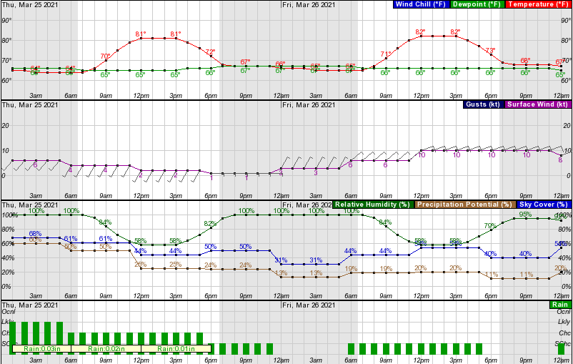


USS John Finn (DDG 113) WEATHER
Navigator
UNCLASSIFIED
Notes:
https://marine.weather.gov/MapClick.php?w0=t&w1=td&w2=hi&w3=sfcwind&w3u=0&w4=sky&w5=pop&w6=rh&w7=rain&AheadHour=40&Submit=Submit&FcstType=graphical&textField1=21.1957&textField2=-158&site=all&unit=0&dd=&bw=&marine=1

Slide 6
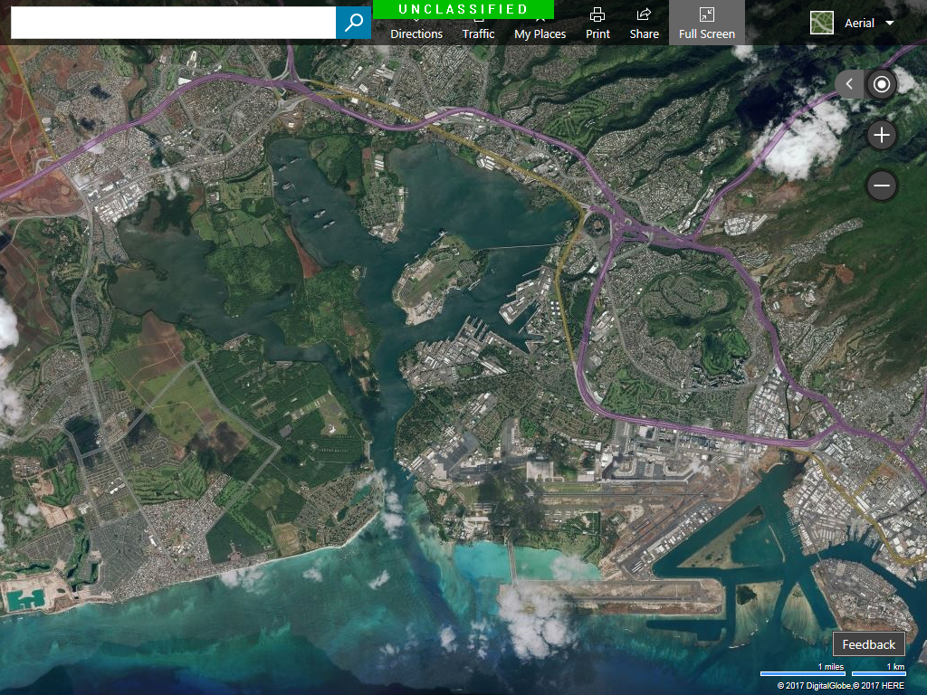
USS John Finn (DDG 113) TIDES
Navigator
TIDE
FORD ISLAND FERRY DOCK
TIDE
BISHOP POINT
UNCLASSIFIED

Slide 7
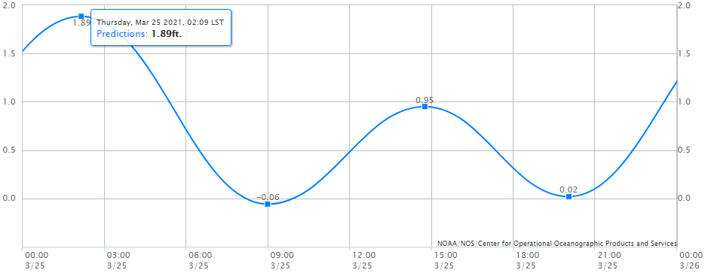
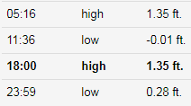
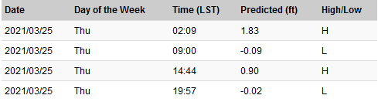
USS John Finn (DDG 113) TIDES
Navigator
Pearl Harbor, Ford Island Ferry
1515 +0.65 ft MLLW
UNCLASSIFIED
Notes:
https://tidesandcurrents.noaa.gov/tide_predictions.html?gid=1399

Slide 8
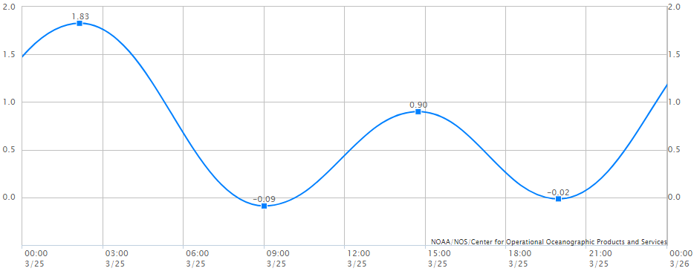
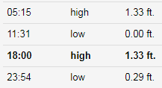
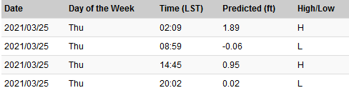
USS John Finn (DDG 113) TIDES
Navigator
Pearl Harbor Entrance, Bishop Point
1530 +0.65 ft MLLW
UNCLASSIFIED
Notes:
https://tidesandcurrents.noaa.gov/tide_predictions.html?gid=1399

Slide 9
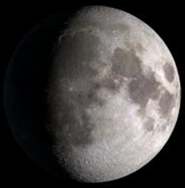
USS John Finn (DDG 113) ASTRONOMICAL DATA
Navigator
Sunrise:
Sunset:
Moonrise:
Moonset:
0630
1845
1603
0519
Moon Phase: Waxing Gibbous
Lunar Illumination: 94%
UNCLASSIFIED
Notes:
Admiralty Total Tides

Slide 10
USS John Finn (DDG 113) NAVIGATION DATA
Navigator
VMS
DNC | 13
LNTM | 12 / 21
NTM | 12 / 21
HYDROPAC | 904/2021
NAVAREA XII | 124/2021
Shoal Water | 36ft (black in VMS)
GPS Datum | WGS 84
Charts | H1356280 A1356285 COA13C GEN13C
LOCAL INFO
Buoyage System | IALA B (red, right, returning)
Line of Demarcation | Line from Barber’s Point Light to Diamond Head Light
VTS | None
Degaussing | Range IVO Waipio Point Monitor BTB CH 74
NAVIGATION MESSAGES
NAVCERT MSG DTG | 042035ZOCT16 082100ZJUN17 031935ZAUG18
UNCLASSIFIED

Slide 11
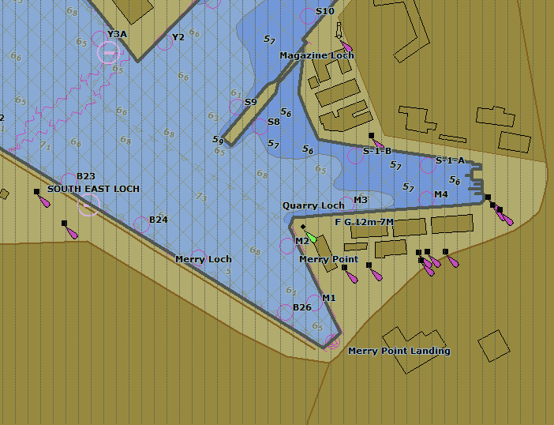
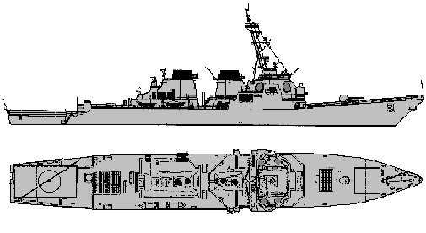

USS John Finn (DDG 113) NAVIGATION DATA
Navigator
PIER INFORMATION
PIER | M1
BERTH | 1 PST
PIER HDG | 154°T / 144°M
MAG. VAR | 10°E
SURF. WINDS | SW 6KTS
INT’L CALL SIGN (NJFN) | Closed up pier side Hauled down LOD
BATTLE FLAG (MEDIUM SIZE) | Closed up pier side
SW 6 KTS
UNCLASSIFIED

Slide 12
USS John Finn (DDG 113) SPECIAL CONSIDERATIONS
Navigator
Honors: IAW NTP 13(B)
Flag Officer movements: N/A
Visitors: N/A
Harbor exercises: N/A
Debrief: In the pilothouse once S&A detail is secured
Uniform: FRVs with command ball caps
UNCLASSIFIED

Slide 13
USS John Finn (DDG 113) TRACK
Conning Officer
Danger bearings/ranges: N/A
Shoal: Marked in BLACK, danger sounding of 36 ft
Channel depth:
Channel width:
LOCATION | LEFT OUTSIDE QUARTER | MIDDLE HALF | RIGHT OUTSIDE QUARTER
Outer entrance channel (up to Beacon 5) | 48.8 ft | 48.8 ft | 59.8 ft
Entrance channel (NAV beacon 5-19) | 41.9 ft | 41.9 ft | 41.1 ft
Main channel | 43.8 ft | 43.8 ft | 43.8 ft
South channel | 36.6 ft (Shallowest)
Turning basin | 41.4 ft (Shallowest)
LOCATION | WIDTH
Outer entrance channel | 100 yds
Entrance channel | 100-251 yds
Main channel | 158 yds
South channel | 282 yds
Turning basin | 380 yds
UNCLASSIFIED
Notes:
Fleet guide reports South CH and turning basin dredged to 45 feet (MMLW)

Slide 14
USS John Finn (DDG 113) TRACK DATA SHEET
Conning Officer
* ALL TURNS BASED ON A STANDARD RUDDER*7
LEG | COURSE | DISTANCE | SPEED | TB | TR
1 | 245°T /235°M | 625 YDS | 6 | N/A | N/A
2 | 246°T / 236°M | 849 YDS | 6 | JW 165°T / 262°R | R15 509 YDS
3 | 183°T / 173°M | 2,442YDS | 10 | TIKI 233°T / 056°R | R6 698 YDS
4 | 168°T/ 158°M | 1,598YDS | 10 | POKE 048°T / 250°R | R3 742 YDS
5 | 154°T/144°M | 7,140 YDS | 15 | N/A | N/A
6 | 180°T/170°M | 10,980 YDS | 15 | N/A | N/A
UNCLASSIFIED
Notes:
TB – COURSE = R DECIMAL x 2K = YDS

Slide 15
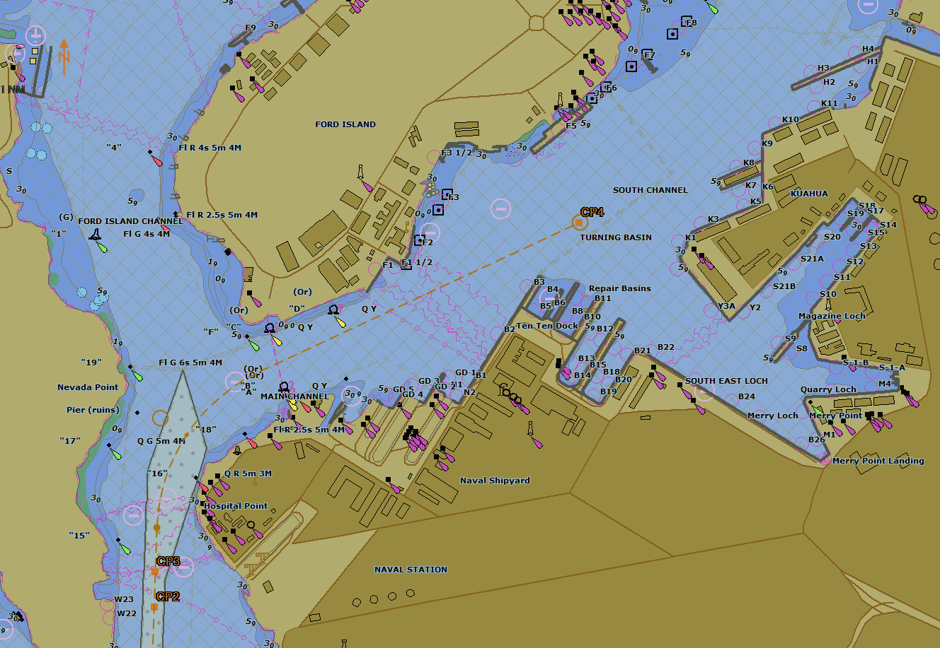
USS John Finn (DDG 113) TRACK
Conning Officer
USS ARIZONA MEMORIAL: NO WAKE ZONE
1
C- 245°T / 235°M
S- 6 KTS
D- 625YDS
2
C- 246°T / 236°M
S- 6 KTS
D- 849 YDS
PIER M1
R15
TB1 JW: 165°T / 262°R
T1 R15: 509YDS

Slide 16
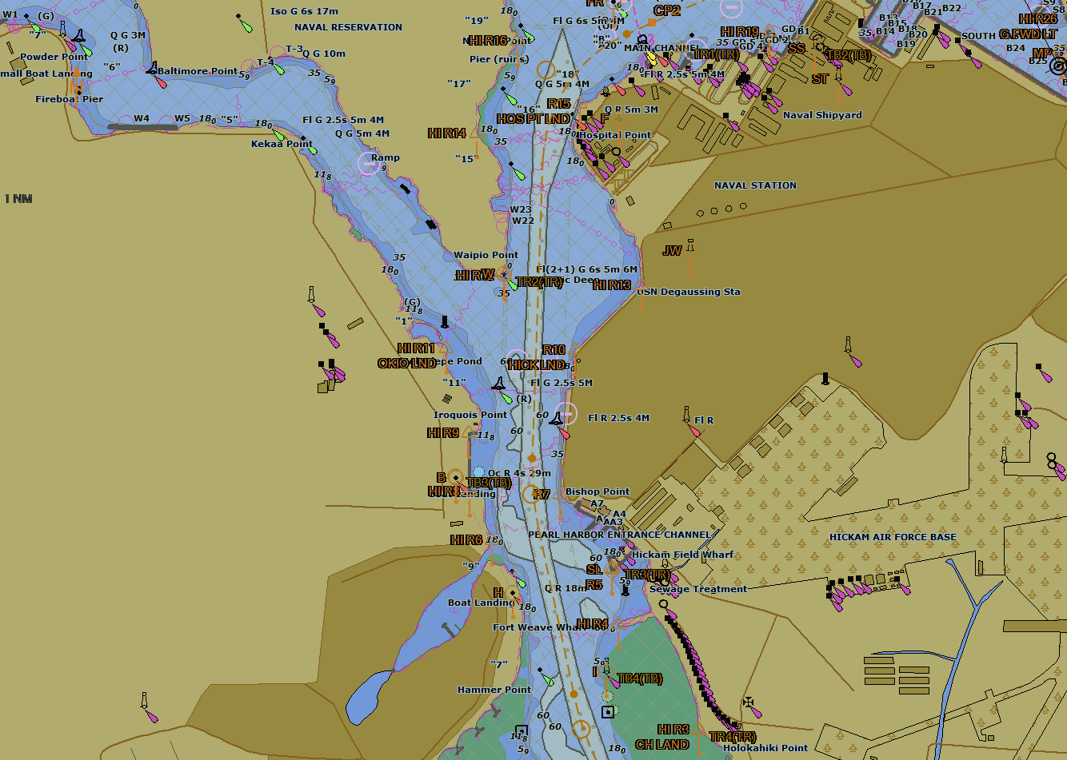
USS John Finn (DDG 113) TRACK
Conning Officer
3
C- 183°T/173°M
S- 10 KTS
D- 2,442 YDS
T
R6
PILOT DROP OFF
4
C- 168°T / 158°M
S- 10 KTS
D- 1,598 YDS
TB2 TIKI: 233°T / 065°R
TB3 P: 048°T / 250°R
P
TR2 R6: 698 YDS
TR3 R3: 742 YDS

Slide 17
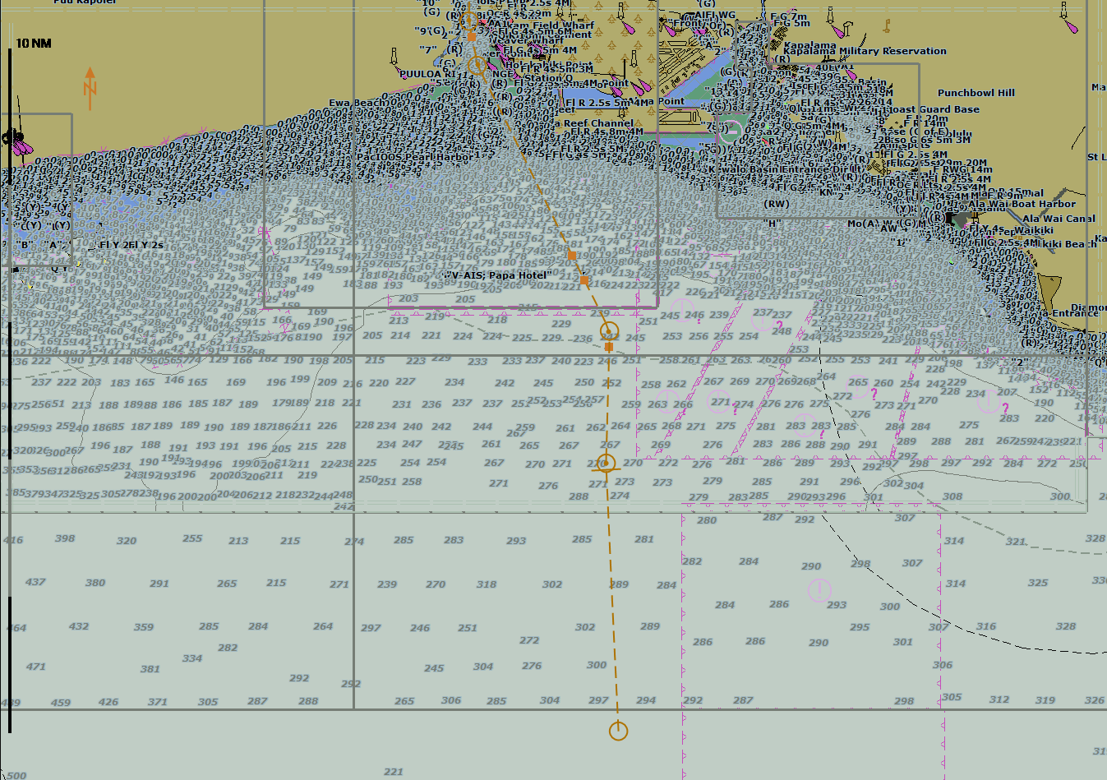
USS John Finn (DDG 113) TRACK
Conning Officer
TB1 DIAMOND HEAD: 088.5°T / 088.5°R
TB2 HOLOKAHIKI POINT: 068.4°T / 042.4°R
5
C- 154°T / 144°M
S- 15 KTS
D- 7.140 YDS
Speed Restricted 10 kts
Line of Demarcation
BUOY 1
Holokahiki Pt Church
6
C- 180°T / 170°M
S- 15 KTS
D- 10,980 YDS
“PH”
6
C- 180°T / 170°M
S- 15 KTS
D- 11,260 NM
TR1 AIRFIELD: 6,420 YDS
TR2 BISHOP POINT: 1,541YDS
UNCLASSIFIED

Slide 18
USS John Finn (DDG 113) GROUND TACKLE
1st LT
Ready anchor: Centerline
Scope of chain: 5 times depth of water
Method of letting go/weighing anchor: From the brake
EQUIP | STATUS
FWD Capstan
AFT Capstan
Windlass
Accommodation Ladder | (STOWED)
1217 IRISH GUNNER | (RLB)
1218 HAWAIIAN WARRIOR
UNCLASSIFIED

Slide 19
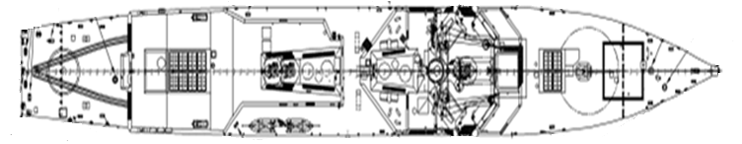
USS John Finn (DDG 113) MOORING CONFIGURATION
1st LT
Pier M1
UNCLASSIFIED

Slide 20
USS John Finn (DDG 113) OPERATIONAL CONSIDERATIONS
OPS
HARBOR MOVEMENTS
TIME | UNIT | FROM | TO
0900 | SYDENY | SEA | H2
1530 | USS Chicago | S-11 | SEA
Harbor special event: NONE
Media coverage: Not Anticipated
Flight ops (FOD/VERTREP PAX transfer): N/A
Hot areas: N/A
UNCLASSIFIED

Slide 21
USS John Finn (DDG 113) TUG AND PILOTS
Navigator
Tug and Pilot: 1 pilot CAPT Stark, Tiger 1 and 3
Pick up: Pierside
Drop off: IVO Hospital Point
Comms: BTB CH 16, 69
INTERNAL COMMUNICATIONS
STATION | PRIMARY | SECONDARY
NAVIGATION | NET 22 | X1JV
LOOKOUT | NET 52 | X27J
STEERING | NET 53 | X40J
DECK | NET 56 | SWICS B09
CO BATTLE NET | NET 15 | NET 16
GUARD STATIONS
NAVY RED | CIC
FLT TAC | CIC
BTB | BRIDGE
UNCLASSIFIED

Slide 22
USS John Finn (DDG 113) COVID-19 Considerations
Navigator
Requirements
Clean and sanitize bridge one hour prior to arrival
Essential personnel on the bridge only
Hand sanitizer available on the bridge
No handshakes
Adhere to physical distancing
All personnel will be wearing masks
UNCLASSIFIED

Slide 23
USS John Finn (DDG 113) STATUS OF NAVIGATION EQUIPMENT
QMOW
GYRO/REPEATER STATUS (25MAR)
GYRO ERROR: 0.1°E | REPEATER ERROR | TOTAL ERROR
METHOD: Azimuth
Centerline Pelorus | 0.0° | 0.1°E
SCC | 0.1°E | 0.2°E
PORT | 0.3°E | 0.4°E
STBD | 0.1°E | 0.2°E
Aft Steering | 0.2°W | 0.1° W
RADAR ERROR
RADAR | BEARING ERROR | RANGE ERROR
SPS-67 (25MAR) | 0.5°E | 21 YDS LNG
BME (25MAR) | 0.5°E | 62 YDS LNG
UNCLASSIFIED

Slide 24
USS John Finn (DDG 113) STATUS OF NAVIGATION EQUIPMENT
Navigator
ECDIS-N
EQUIP | STATUS
NAV 1
NAV 2
NAV 3
CONN 1
CONN 2
HFS
BCCS
CO LAPTOP
SPCS
NAV EQUIPMENT
EQUIP | STATUS | EQUIP | STATUS
FWD WSN-7 |  | Fathometer
AFT WSN-7 |  | VHF (BTB)
DEML |  | Ship’s Whistle
GPS 1 |  | NAV Lights
GPS 2 |  | AIS
RTS 1 |  | MORIAH
RTS 2 |  | STBD MFCR
SPS-67 |  | PORT MFCR
BME |  | SPA-25 (Bridge)
DFGMC |  | SPA-25 (CIC)
ENL
EQUIP | STATUS
ENL
DAGR
UNCLASSIFIED

Slide 25
USS John Finn (DDG 113) STATUS OF ENGINEERING PLANT
PCO
POWER/PROPULSION
GTM |  | CONDITION
1A |  | Online
1B |  | Online
2A |  | Online
2B |  | Online
GTG |  | CONDITION
1 |  | Online
2 |  | Running Offline
3 |  | Online
Thrust Control: SCC Lee Helm
Auxiliary Control: UCC1
RMD: Pierside
STEERING
HPU |  | CONDITION
1A |  | Online
1B |  | Running Offline
2A |  | Online
2B |  | Running Offline
Steering Control: SCC Helm
Computer Manual
MISC
Degaussing | ON
Limiting Casualties | N/A
UNCLASSIFIED
Notes:
NAVDORM delineates “Engineer Officer (or Reactor Officer/Plant Control Officer)” specifically, not the EOOW.

Slide 26
USS John Finn (DDG 113) RMD
PCO
Maximum plant reliability will be set prior to setting RMD
Specific deviations from EOCC that may not be conducted without CO permission:
Do not take thrust or pitch control from the Bridge
Do not secure the last engine on each shaft
For shafting casualties, do not stop either shaft
Do not go to single generator operations
Do not electrically isolate any switchboard
Do not perform any planned/corrective maintenance or authorize new tag outs
UNCLASSIFIED

Slide 27
USS John Finn (DDG 113) LOSS OF STEERING
Master Helmsman
Report to CONN, “Loss of steering control”
Depress EMERGENCY OVERRIDE TO MANUAL pushbutton; verify BACKUP MANUAL is displayed on the SCC
Verify power unit RUN and RUDDER ENGAGE indicators are illuminated for both rudders
Test for rudder control; report to CONN
Shift to standby power units
Select the standby pumps Engage buttons
Select the online pumps STOP buttons
Verify Port/Stbd Run and Engage indicators illuminate for standby units and extinguish for online units
Test for rudder control; report to CONN
Shift to after steering
UNCLASSIFIED
Notes:
OOD to brief verbally loss of steering

Slide 28
USS John Finn (DDG 113) LOSS OF STEERING
AFT Steering Helm
Shift to after steering
Depress EMERGENCY OVERRIDE TO MANUAL pushbutton; verify AFT is displayed as steering control location
Test for rudder control; report to CONN via net 53
If steering is regained, CONN will issue a new order via net 53
Shift to LCUs
Turn engaged HPU LCU HELM CONTROL switched to LOCAL
Test for rudder control; report to CONN via net 53
If required, engage standby power units
Turn engaged HPU LCU HELM CONTROL switched to LOCAL
Test for rudder control; report to CONN via net 53
If steering is regained, CONN is limited to giving rudder orders only
NOTE: If steering control is not regained at the LCU, operational steering is not possible.
Shift to Fill and Drain Pump
Shift to Manual Hand Steering Pump
Shift to Ratchets
UNCLASSIFIED
Notes:
OOD to brief verbally loss of steering

Slide 29
USS John Finn (DDG 113) LOSS OF THRUST CONTROL
LEE HELMSMAN
Report to CONN, “Loss of thrust control”
CCS will take thrust control from the pilothouse IAW MLTC
CCS will than test for positive thrust control by +/- 2 shaft RPM or +/- 2% pitch and report to the JOOD via net 53
UNCLASSIFIED

Slide 30
USS John Finn (DDG 113) EMERGENCIES
OOD
Loss of Steering:
Pass the word on the 1MC
Ensure positive communications with after steering via net 53
Slow to safe speed
Make PAN PAN call over BTB to inform ships in the vicinity
Hoist ball over ball, energize red over red
If steering control is not regained at the LCU, CONN will attempt to steer ship using various RPM and PITCH combinations
Man Overboard:
Drop smoke float and life ring
Sound six short blasts of the ship’s whistle
Pass the word on the 1MC, ship riders will muster on messdecks
Make PAN PAN call over BTB to notify ships in vicinity
Hoist OSCAR, energize red over red pulsating lights
Primary means of recovery will be tugs or harbor security boats
Medical will be standing by on recovery station to assist
UNCLASSIFIED
Notes:
OOD to brief verbally loss of steering

Slide 31
USS John Finn (DDG 113) EMERGENCIES
OOD
Loss of Gyro:
Shift to secondary gyro
If gyro is not restored, shift to DFGMC
Navigation will shift to a relative plot
NOTE: If loss of steering occurs while JFN has a loss of gyro, CONN will drive with rudder in hand.
Loss of VMS Display:
Shift to alternate VMS display on the bridge
Loss of primary position source (GPS 1):
Shift to GPS 2
Shift to DAGR
Shift to Visual/radar/composite
Shift to COTS GPS
Loss of RADAR:
Upon loss of SPS-67, shift to BME, then steer by seaman's eye.
UNCLASSIFIED

Slide 32
USS John Finn (DDG 113) EMERGENCIES
OOD
Loss of external communications:
Shift to handheld BTB radios. Upon loss of handheld BTB, shift to signal flags.
Reduced visibility:
JOOD complete low visibility checklist
Station the low visibility detail
Slow to safe speed
Energize navigation lights
Sound fog signals IAW NAVIGATION RULES
Emergency anchorage locations:
Restricted to the channel until buoys 1 & 2
IVO Waipio Point slightly east of the channel
IVO South Channel and Turning Basin
Caution must be exercised to avoid cables and pipeline crossings
UNCLASSIFIED

Slide 33
USS John Finn (DDG 113) EMERGENCIES
EOOW
Propulsion Casualties:
Throttle control will remain in the Pilothouse at the Ship’s Control Console (SCC).
If there is a loss of display/control, thrust will shift to the MCS PACC Console.
Test for propulsion control by +/- 2 shaft RPMs or 2 percent pitch.
Battle Override will be activated on last GTM on each shaft. The CO will be notified immediately when Battle Override is activated.
CRP Casualties:
The affected OD box operator will take local manual control of pitch and answer “percent pitch” commands as directed by the helm safety officer on net 53
Testing of pitch control will be of no more than +/- 2 percent.
Electrical Plant Casualties:
If possible, EOOW parallel the standby generator with the properly functioning GTG prior to opening the GTG breaker of the affected GTG. EPCC actions shall be such that ZEDS is not interrupted.
In the case of a loss of generator, follow normal EOCC but DO NOT RE-ENERGIZE a dead bus.
In the event of a loss of two generators, the EPCC will manually initiate stage two load shed in order to maintain propulsion and steering.
UNCLASSIFIED

Slide 34
USS John Finn (DDG 113) FORCE PROTECTION PLAN
GLO
SCAT status: (4) .50 cals, (2) ROCs will be manned
Small boat escort: N/A
PPRs: IAW JOHNFINNINST 3300.1B
COMMS plan: Primary – SIWCS 9B
Secondary – NET 68
508
252
c
502
c
c
501
507
251
UNCLASSIFIED

Slide 35
USS John Finn (DDG 113) RISK ASSESSMENT/ORM
Navigator
HAZARD | ASSESS | RAC | CONTROL | ASSESS | RRAC | SUPERVISOR
Collision | D/I | 2 | Utilize BTB early, build SA by monitoring current ship movements, shipping officer on station, make course changes early, maneuver IAW the ROTR and sound danger signal as necessary, AIS in transmit | E/I | 3 | OOD, NAV, XO, CO
Allision | D/I | 2 | Channel is well marked, safeties on fo’c’sle and flight deck passing ranges to the pier and watching for buoys. | E/I | 3 | DECK SAFETIES, NAV, XO, CO
Grounding | D/I | 2 | Shoal water marked in black, NAV reports as required, verbal fathometer readings | E/I | 3 | SONAR, NAV, XO, CO
NAV Equip. Malfunction | C/II | 2 | Casualty control procedures in place, redundant systems in place pre underway checks complete, NAV ET on station | D/II | 3 | NAV ET, NAV, XO, CO
UNCLASSIFIED

Slide 36
USS John Finn (DDG 113) RISK ASSESSMENT/ORM
Navigator
HAZARD | ASSESS | RAC | CONTROL | ASSESS | RAC | SUPERVISOR
Comms Failure | C/II | 2 | Redundant systems in place, secondary comms identified and briefed pre-underway checks complete | D/II | 3 | CICWO, OOD
Breakdown in BRM | C/III | 3 | Briefed NAV plan, charts up to date, charts reviewed and approved, qualified personnel on station, forceful backup | D/III | 4 | CONN, JOOD, OOD, NAV, XO, CO
Distraction/ Fatigue | C/II | 2 | Supervisors keep watchstanders focused on the mission, emphasize safety is paramount, maintain quiet on station | D/II | 3 | CICWO, OOD, NAV, XO, CO
Unfamiliar port | B/II | 3 | Watchteam briefed and reminded to keep priorities in check. Charts and plan reviewed and approved. | C/II | 3 | NAV, OOD, XO, CO
UNCLASSIFIED

Slide 37
USS John Finn (DDG 113) RISK ASSESSMENT/ORM
Navigator
HAZARD | ASSESS | RAC | CONTROL | ASSESS | RRAC | SUPERVISOR
Man Overboard | D/I | 2 | Utilize RHIB, tugs if available, ensure lifelines are properly rigged, safety brief conducted, safety observers and HM on station | E/I | 3 | DECK SAFETIES
Line Handling Mishap | D/I | 2 | Safety brief conducted, safety observers and HM on station, enforcing proper PPE | E/I | 3 | DECK SAFETIES
Steering/ Propulsion Casualty | D/I | 2 | Casualty control procedures in place, redundant systems in place, steering checks conducted, loss of steering and loss of thrust procedures reviewed on station when S&A is set, RMD/Max Plant Reliability set | E/I | 3 | MASTER HELM, HELM SAFETIES, EOOW, CONN, OOD
Inclement Weather | D/II | 3 | Maintain a proper lookout & safe speed at all times, muster low visibility detail in conjunction with S&A detail | E/II | 4 | CICWO, CONN, OOD, NAV, XO, CO
COVID-19 | D/II | 3 | Ensure sanitizer and wipes are on station. Ensure all personnel are wearing masks and maintaining social distancing. | E/II | 4 | OOD, CONN, JOOD, NAV, XO, CO, PILOT ESCORT
UNCLASSIFIED

Slide 38
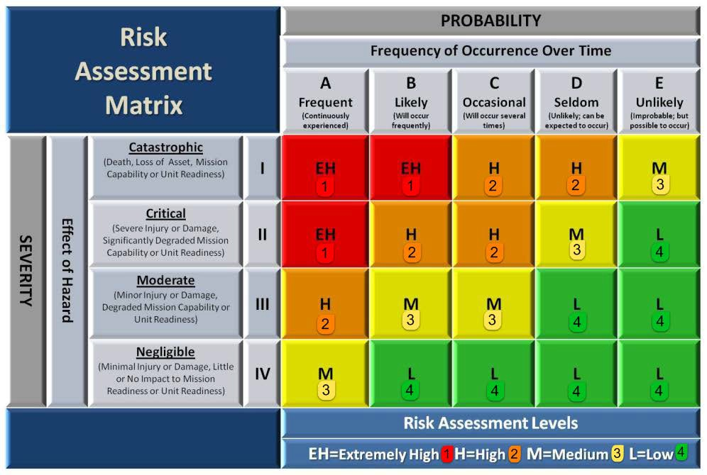
USS John Finn (DDG 113) RISK ASSESSMENT/ORM
Navigator
UNCLASSIFIED

Slide 39
USS John Finn (DDG 113) INDIVIDUAL RISK MANAGEMENT
Navigator
WATCHSTATION | WATCH/ REST RATIO | EXPERIENCE | CREW COHERENCE | EQUIPMENT | IRM
OOD: LTJG GORMLEY | 3 | 2 | 4 | 3 | 12
JOOD: ENS CONKEY | 3 | 2 | 4 | 3 | 12
JOOW: LTJG BILDEN | 3 | 2 | 4 | 4 | 13
CONN: ENS PETERSON | 3 | 2 | 4 | 3 | 12
MASTER HELM: RS3 HOWARD | 3 | 2 | 4 | 3 | 12
LEE HELM: BMSN WILLIAMS | 3 | 2 | 4 | 3 | 12
HELM SAFETY: ENS BYROM | 3 | 2 | 4 | 3 | 12
NAV EVAL: LTJG LOWERY | 3 | 3 | 4 | 4 | 14
CICWO: LTJG VALENCIA | 3 | 2 | 4 | 4 | 13
EOOW: GSCS LAPID | 3 | 2 | 4 | 4 | 13
XO: CDR GONZALES | 3 | 3 | 3 | 4 | 13
CO: CDR CATHEY | 3 | 3 | 4 | 4 | 14
OVERALL | 3 | 2.25 | 3.9 | 3.5 | AVE: 12.7
Watch to Rest Ratio:
4: Watch leading into event (or during scheduled watch), 7 hours of sleep in last 24 hours
3: 7 hours of sleep in last 24 hours, stood a full watch before event
2: Between 5 and 7 hours of sleep in last 24 hours
1: Less than 5 hours of sleep in last 24 hours
Crew Coherence:
4: Permanently Assigned Crew
3: Permanently Assigned Crew/TEMADD >6 Months
2: Permanently Assigned Crew/TEMADD between 3-6 Months
1: Permanently Assigned Crew/TEMADD/Cross deck <3 Months
IRM:
<8: Critical
8-10: Serious
11-13: Moderate
13-14: Minor
>14: Negligible
Experience:
4: 11 or more similar evolutions in last 3 months
3: 5-10 similar evolutions in last 3 months
2: 5 or less similar evolutions in last 3 months; or U/I
1: First time as qualified watchstander
Equipment:
4: All equipment operational
3: Slight degradation
2: Moderate degradation
1: Primary / backup equipment OOC
UNCLASSIFIED

Slide 40
USS John Finn (DDG 113) LESSONS LEARNED
Navigator
NSTR
UNCLASSIFIED

Slide 41
USS John Finn (DDG 113) QUESTIONS?
QUESTIONS?
UNCLASSIFIED

